Slide 1

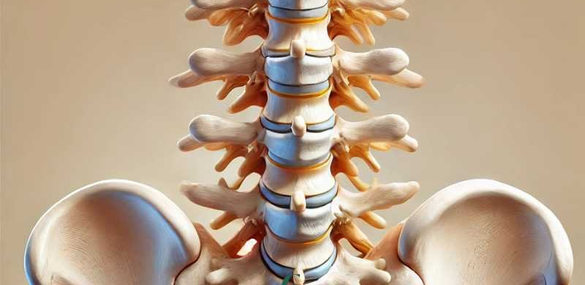
Lumbar Spine
Chris Phillips
PT5050

Slide 2
We will cover...
Anatomy and Physiology of Lumbar Spine and Pelvis
  Overview of vertebral structure, intervertebral discs, ligaments, musculature
  Neural pathways relevant to Lsp
Clinical Application
  Common pathologies
  Mechanism of injury and degeneration
  Therapeutic management of spinal conditions
Biopsychosocial concepts related to spinal conditions

Slide 3
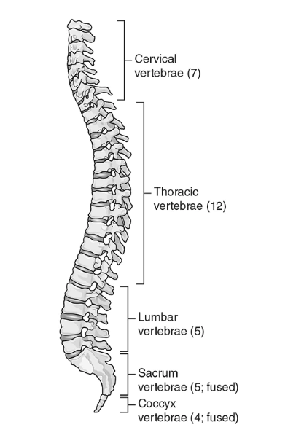
Vertebral column
Five regions of the spine;
  Cervical
  Thoracic
  Lumbar
  Sacrum
  Coccyx
33 vertebral in total

Slide 4
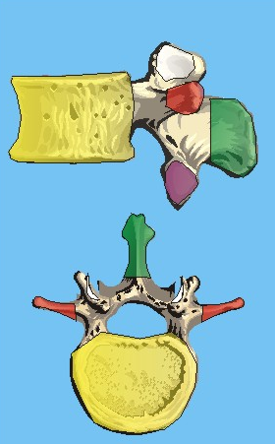
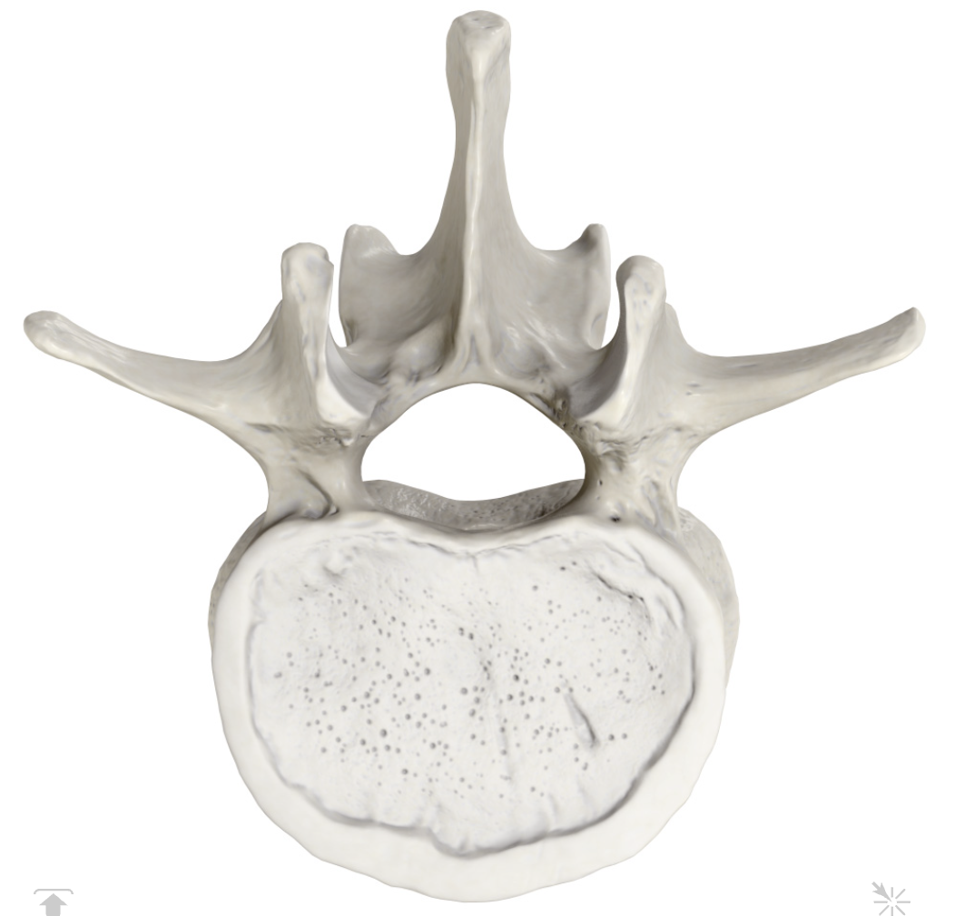
Osseous structures
Body of vertebra
Superior articular process
Transverse process
Posterior
Spinous process
Vertebral foramen
Spinous process
Inferior articular process
Transverse process
Lamina
Anterior
Body of vertebra
Pedicle

Slide 5
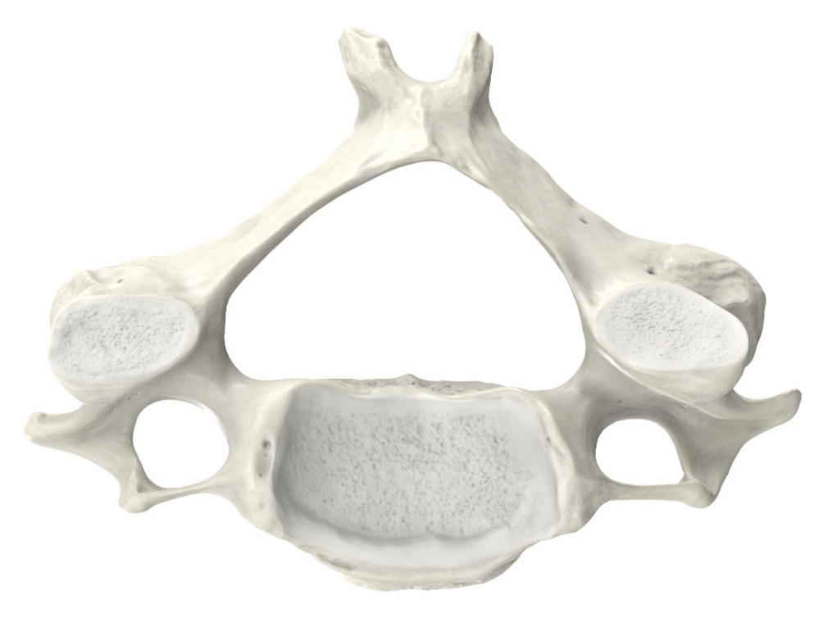
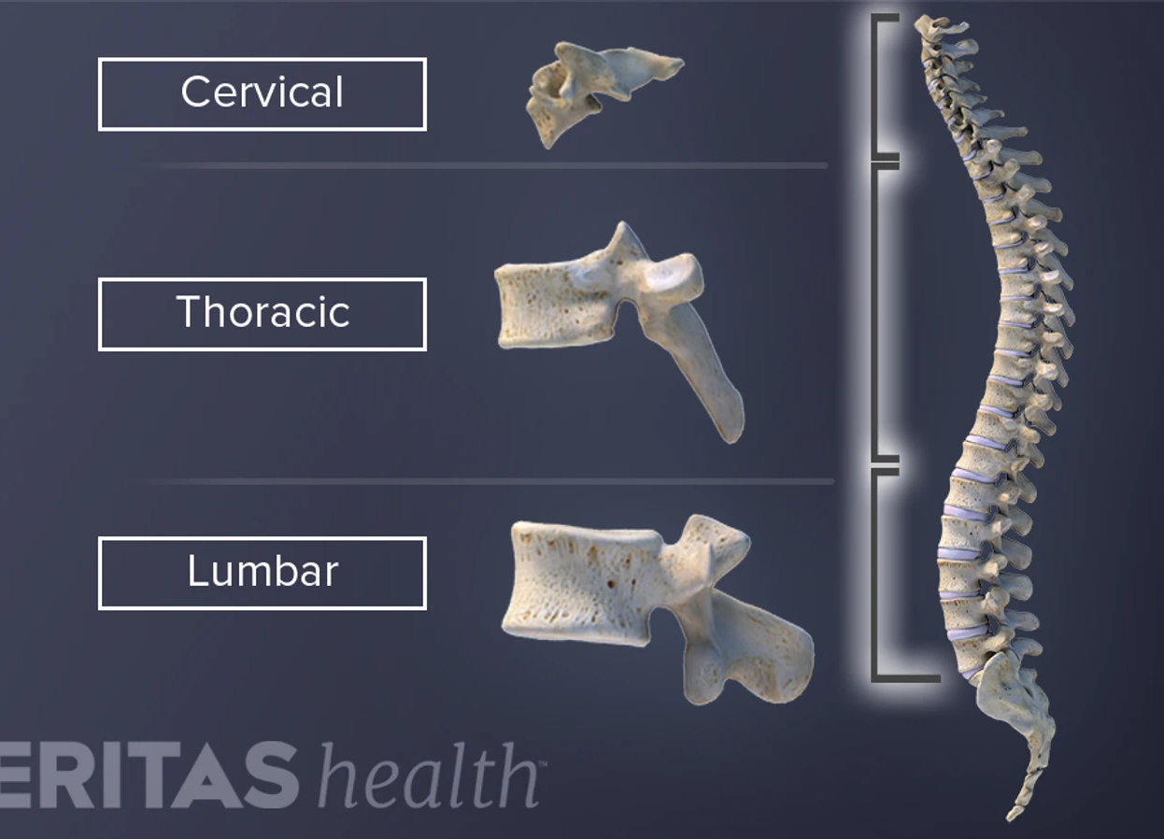
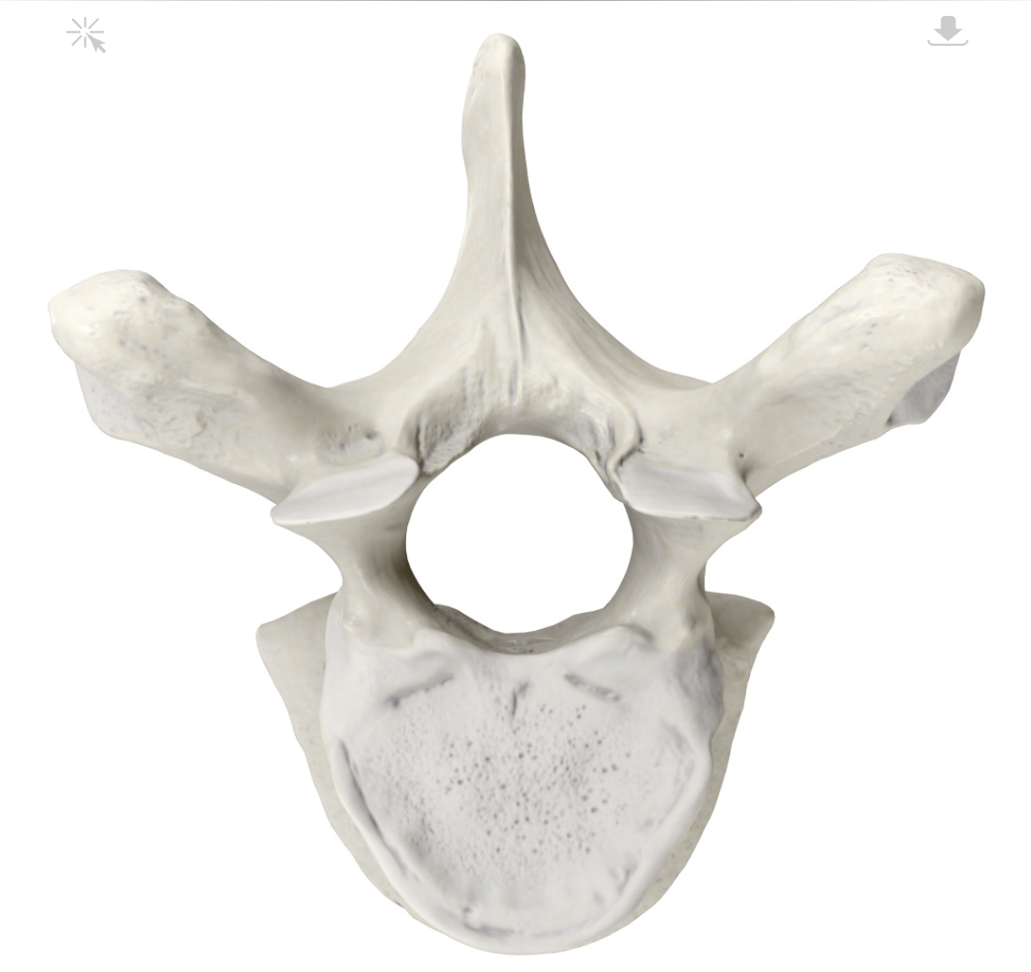
Differentiation of Vertebrae
Cx
Tx
Lx
Lateral view
Superior view

Slide 6
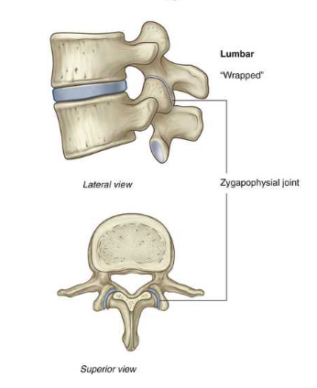
Facet Joints
Joint between the inferior articular process and the superior articular process of the subsequent vertebra
Orientation of the facet joints vary between region to accommodate different functions and movements

Slide 7
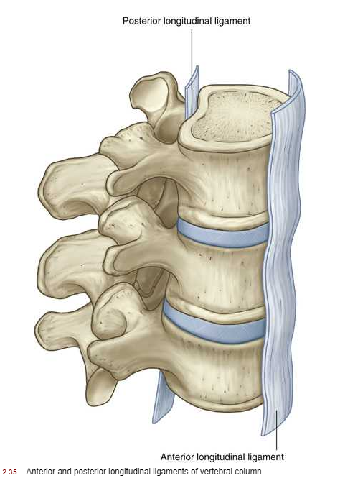
Ligaments
Anterior longitudinal
Posterior longitudinal
Supraspinous Ligament
Interspinous ligament
Intertransverse ligament
Ligamentum flavum

Slide 8
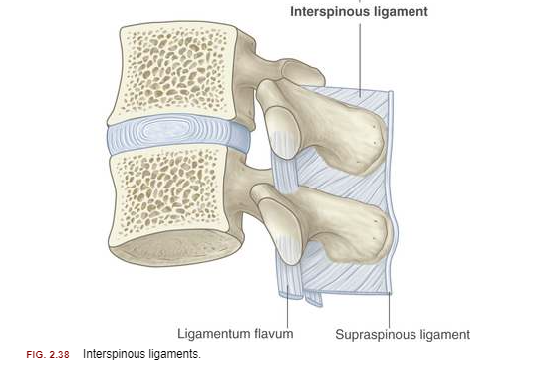
Ligaments
Anterior longitudinal
Posterior longitudinal
Supra - spinous Ligament
Inter - spinous ligament
Ligamentum flavum
Intertransverse ligament

Slide 9
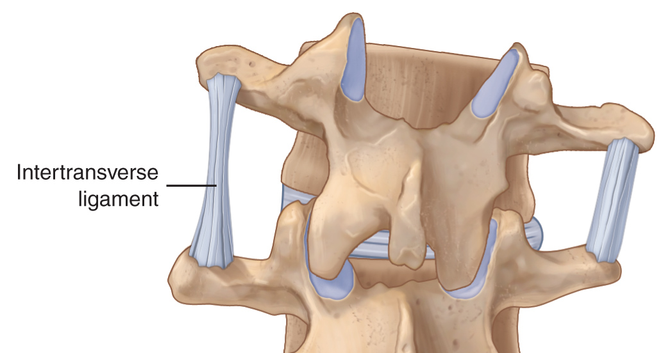
Ligaments
Anterior longitudinal
Posterior longitudinal
Supra - spinous Ligament
Inter - spinous ligament
Ligamentum flavum
Inter - transverse ligament

Slide 10
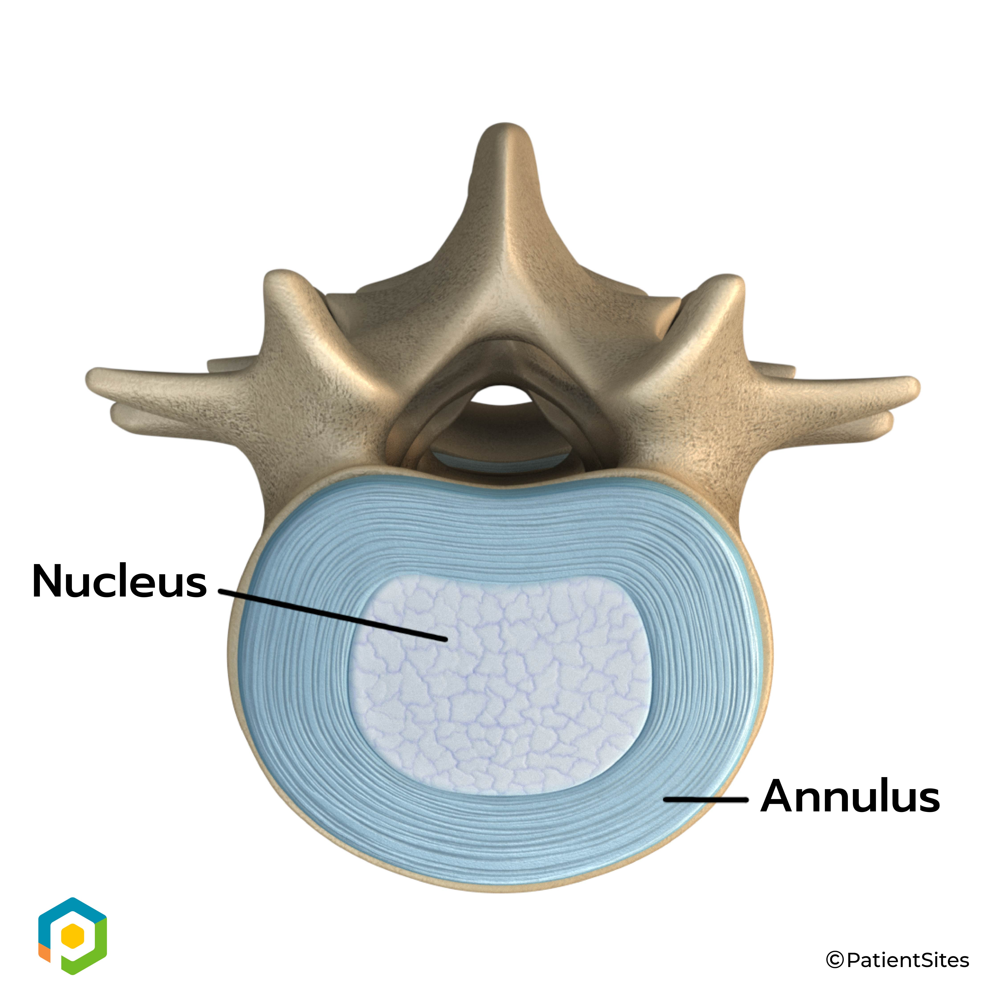
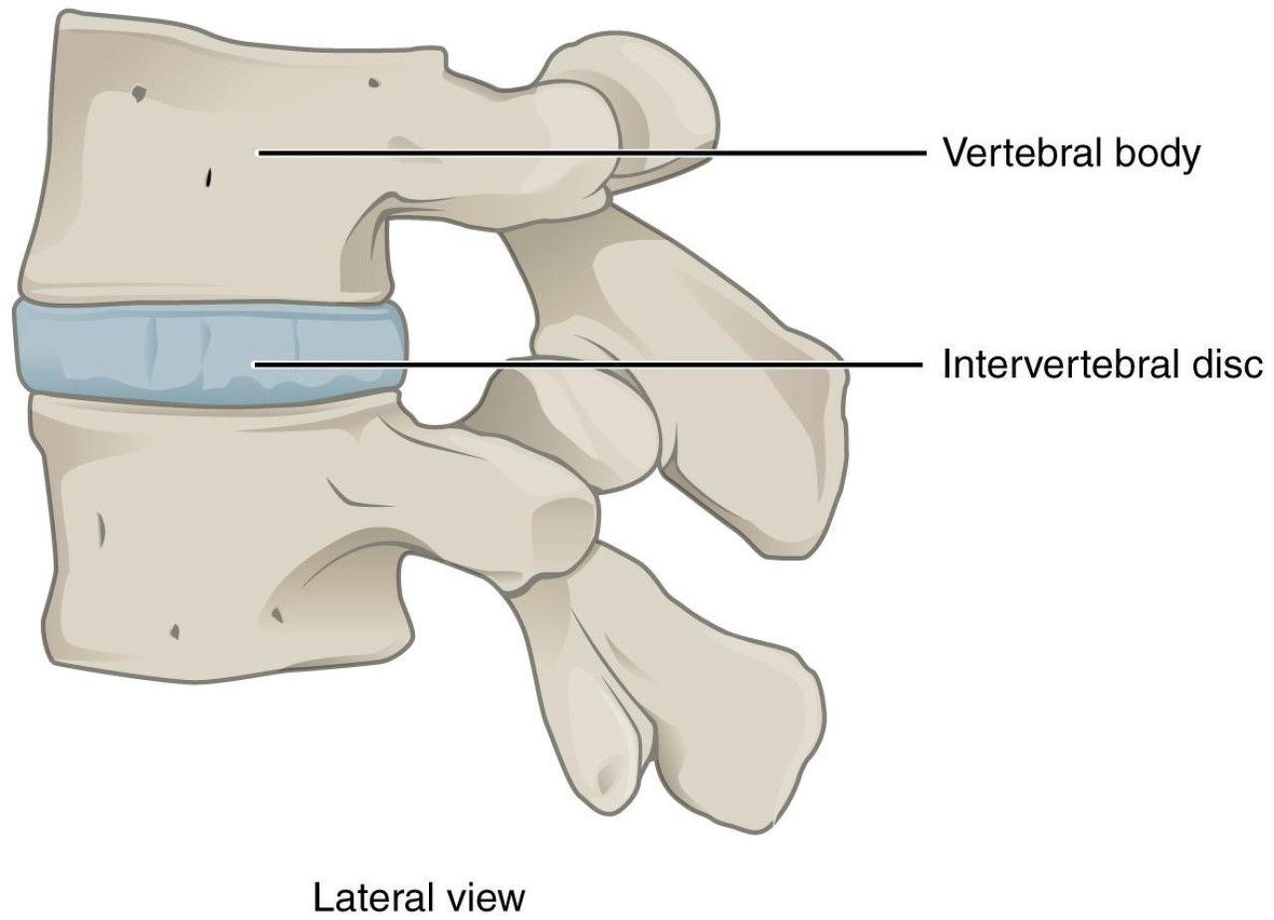
Intervertebral Disc
Annulus fibrosis
Nucleus pulposus
Vertebral end plate

Slide 11
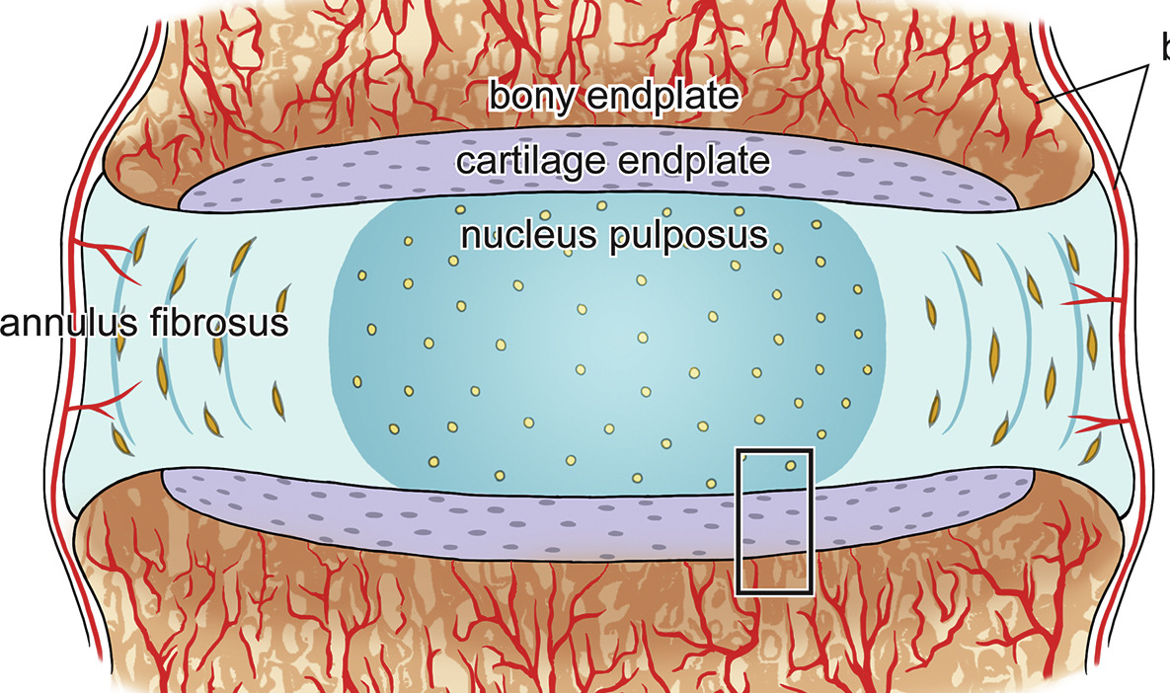
Nucleus pulposus
Central core of the intervertebral disc mainly type II collagen – accepts compressive forces
Gelatinous in nature
Avascular
Tends to be situated more posteriorly
Act as a fulcrum during movement
Transmits compressive loads from one vertebrae to another
Herniation can occur when there is degeneration of the annulus

Slide 12
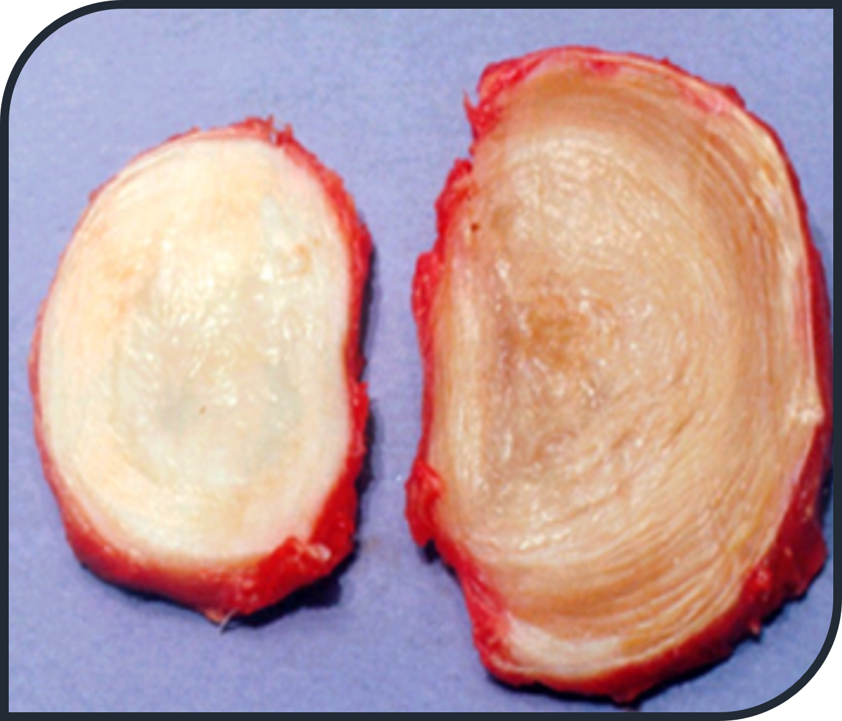
Annulus fibrosis
Consists of concentric rings of predominantly type I collagen tissue (strong!)
Bound together by proteoglycan gel and elastic fibres. Proteoglycans attract water which give discs their cushion effect (shock absorbers)
Composed of layers (lamella)
Outer 1/3 highly innervated with receptors

Slide 13
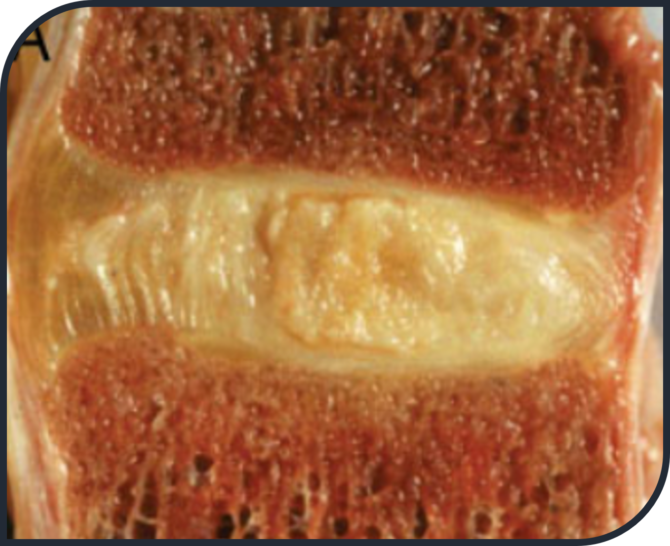
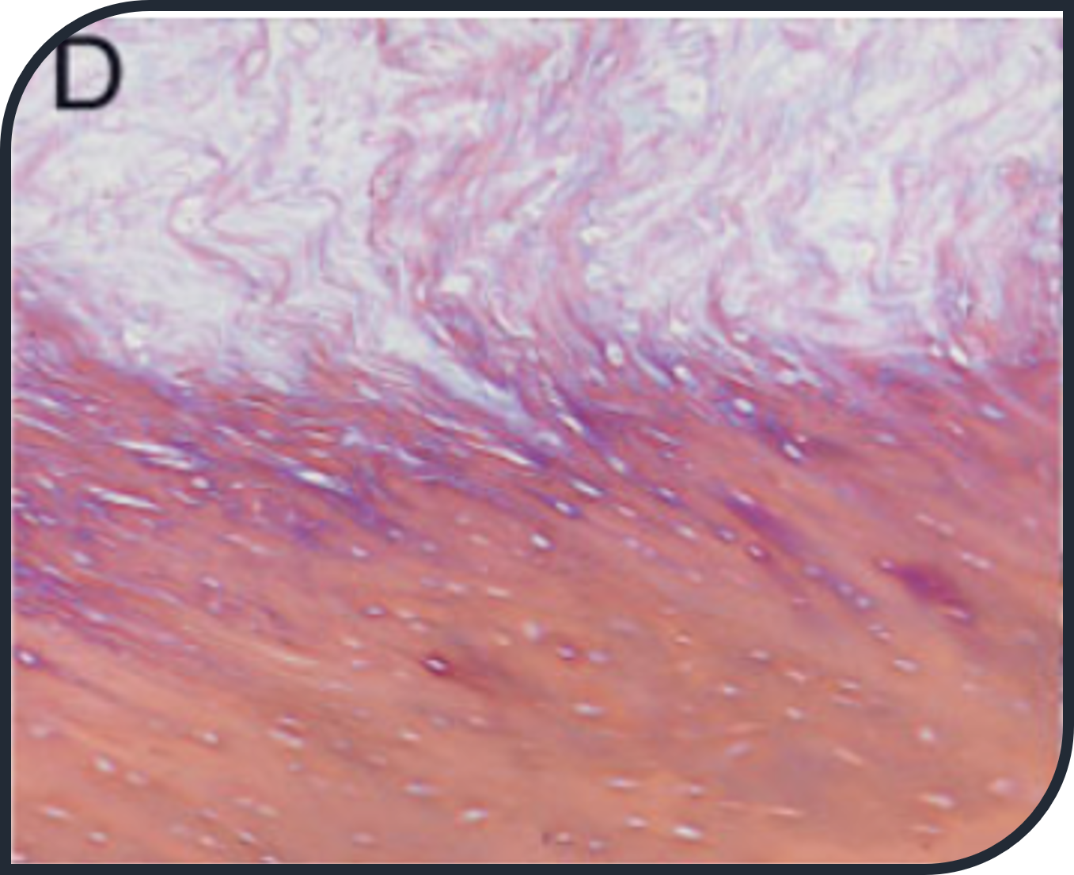
Vertebral end plate
Continuation of annulus fibrosis to transition to vertebral body
Serve as the interface between rigid vertebral bodies and pliant intervertebral disc
Discs don’t have a dedicated blood supply - end plates must balance conflicting requirements of being strong to prevent vertebral fracture and porous to facilitate transport between disc cells
Horizontal collagen fibre orientation

Slide 14
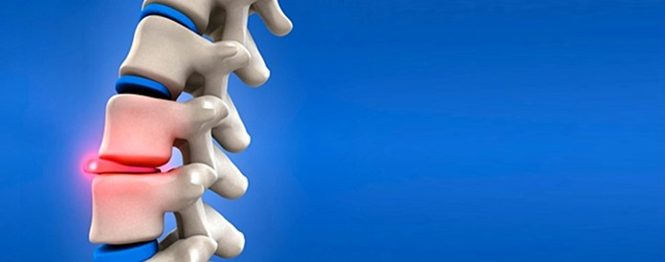

You have slipped a disc!

Slide 15
Lumbar discs
Approximately cylindrical in shape
Each lamella thicker anteriorly than posteriorly therefore disc thinner posteriorly
Collagen in posterior fibres are more closely packed therefore stronger
Wedge shape of the disc contributes to the formation of lordosis
Able to withstand flexion pressure but fatigue predisposes – Rowing up to 53% of injuries are disc related (Thornton et al., 2016)

Slide 16
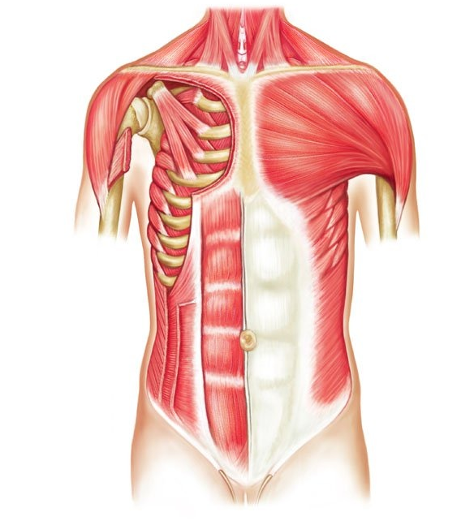
Main mobiliser muscles of the Trunk
Abdominals:
  Rectus abdominis
  External oblique abdominal muscle
  Internal oblique abdominal muscle
  Quadratus lumborum
  Transverse abdominis
Erector Spinae:
  Iliocostalis
  Longissimus
  Spinalis

Slide 17
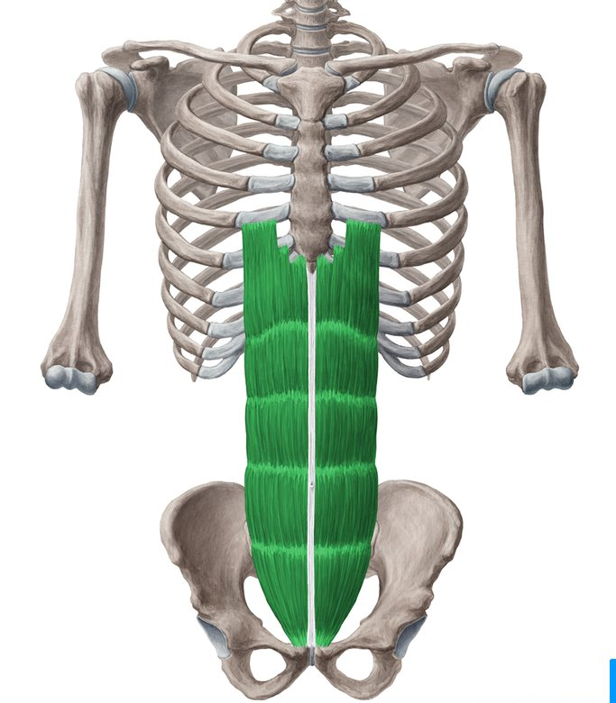
Rectus Abdominus
O: crest of the pubis
I: cartilage of 5th, 6th and 7th ribs
Action:
Lumbar flexion - uses both sides of muscle
Lateral flexion to the right - uses right side muscle
Lateral flexion to the left - uses left side muscle
Innervation: T7-12, (Ventral Rami)

Slide 18
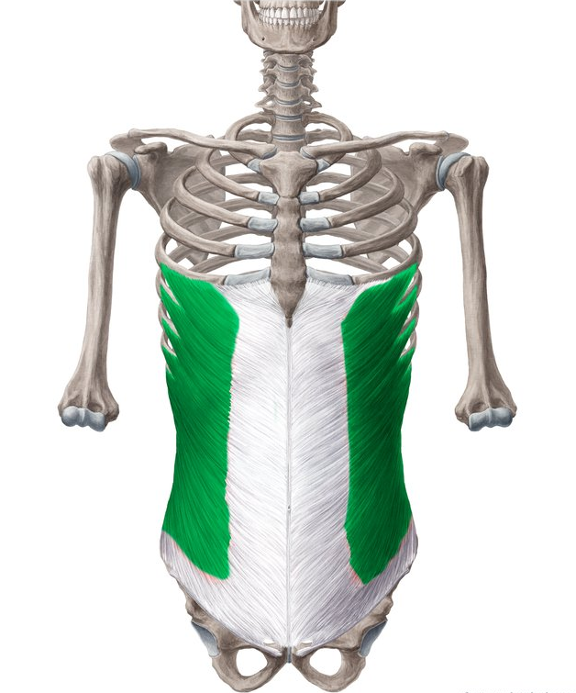
External Oblique Abdominals
O: lower eight ribs
I: crest of the ilium and crest of pubis
Action:
Lumbar flexion - uses both sides of muscle
Right side - lumbar lateral flexion to the right, and rotation to the left
Left side - lumbar lateral flexion to the left, and rotation to the right
Innervation: Upper 2/3 = T7-11, lower costal nerves
Lower 1/3 = T12 – L1, Subcostal nerve + Lumbar plexus

Slide 19
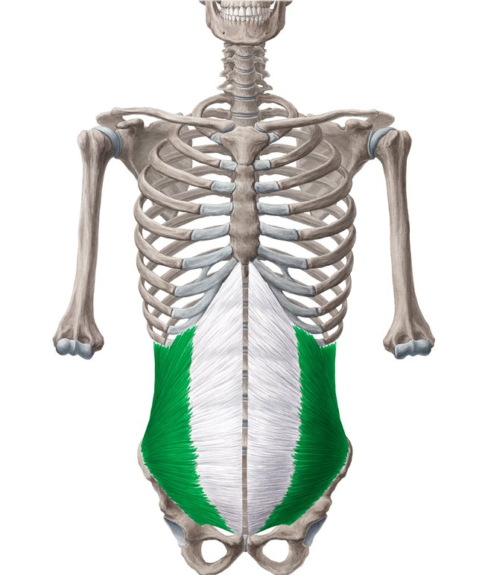
Internal Oblique Abdominals
O: crest of ilium and crest of pubis (via inguinal ligament)
I: cartilages of the lower ribs and linea alba
Action:
Lumbar flexion - uses both sides of muscle
Rotation to the same side
Innervation: T7-T11 + L1, Ventral rami of intercostal nerves +
ilioinguinal nerve

Slide 20
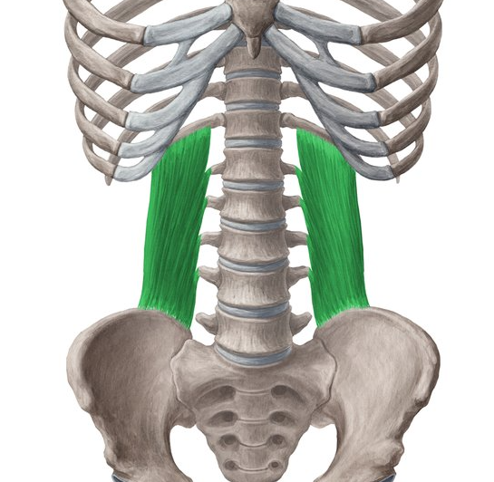
Quadratus Lumborum
O: posterior inner lip of iliac crest
I: lower border of 12th rib; transverse process of upper
lumbar vertebrae
Action:
Lateral flexion on ipsilateral (same) side
Stabilises pelvis
Innervation: T12-L3 ,Subcostal nerve (T12), Iliohypogastric and Ilioinguinal nerve (L1), ventral rami (L2 and L3)

Slide 21
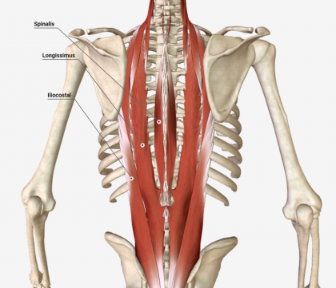
Erector Spinae
O: ilium; sacrum; lumbar and thoracic transverse
processes; cervical and thoracic spinous processes
I: Posterior ribs and cervical and thoracic transverse processes; cervical and thoracic spinous processes; base of the skull
Action:
Extension, lateral flexion, rotation
Innervation: C1-L5 Dorsal Rami of spinal nerve
Spinalis
Longissimus
Intercostalis

Slide 22
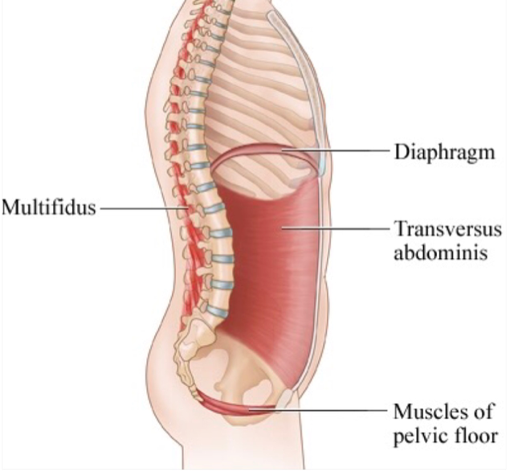
Stabilisers
Transversus abdominis
Multifidus
Also - Rotators, Diaphragm, Pelvic Floor

Slide 23
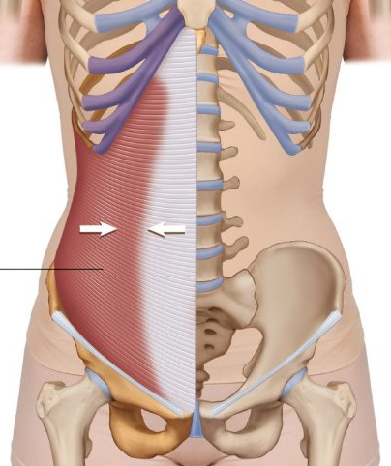
Transversus Abdominis
O:
Lateral third of inguinal ligament and associated iliac fascia,
Anterior two-third of the iliac crest,
Thoracolumbar fascia
Inner surface of lower six costal cartilage and their ribs (7-12)
I:
Linea alba
Aponeurosis of internal abdominal oblique muscle
Pubic crest
Pectinal line of pubis
Innervation: T7-11 intercostal nerves + L1 ilioinguinal and iliohypogastric

Slide 24
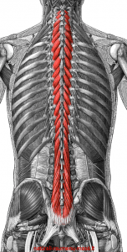
Multifidus
O:
The back surface of the sacrum.
The PSIS
The transverse processes
I:
Spinous process
Action
Stabiliser of Lx, Extension, contralateral rotation
Innervation: Medial dorsal ramus of the spinal nerves

Slide 25
Pelvic girdle anatomy
A ring of bones that attach the lower limbs to the axial skeleton i.e. the vertebral column, via the sacrum
The pelvis made up of two innominate bones which are large, flattened and irregularly shaped fusions of three bones; ilium, ischium, pubis
At birth, these bones are connected by cartilage at the acetabulum and only fuse into one bone around the age of 16-18 years
Anteriorly, the pubic bones articulate with one another
Posteriorly, the ilium articulates with the sacrum

Slide 26
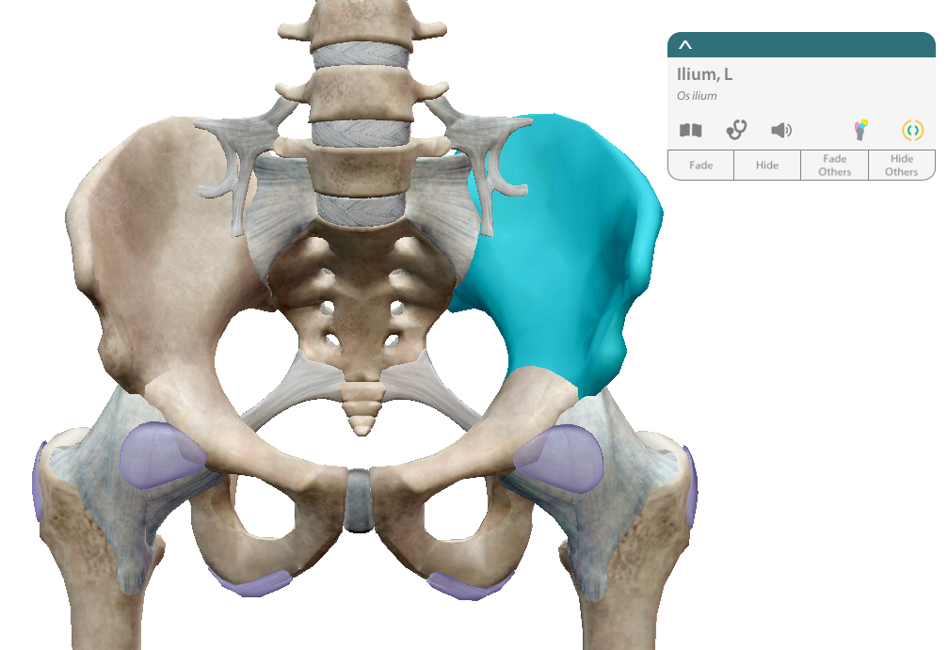
Ilium

Slide 27
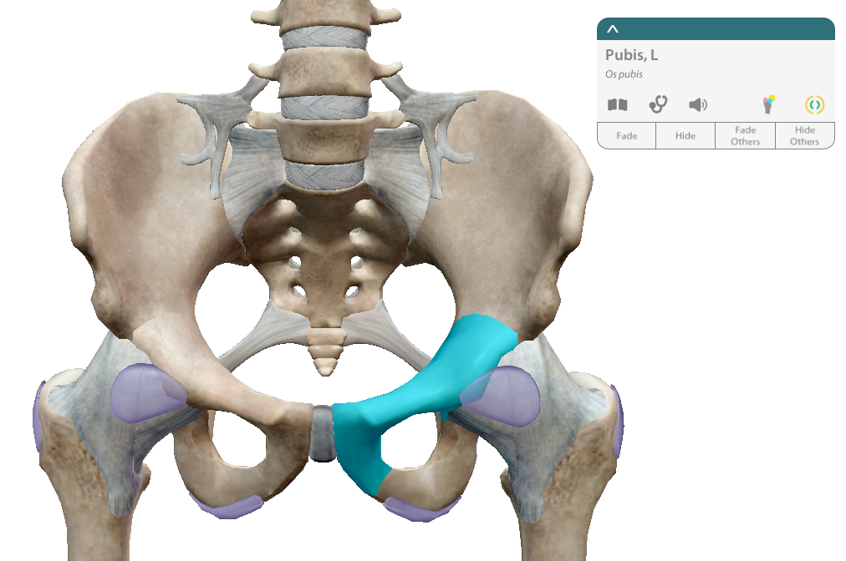
Pubis

Slide 28
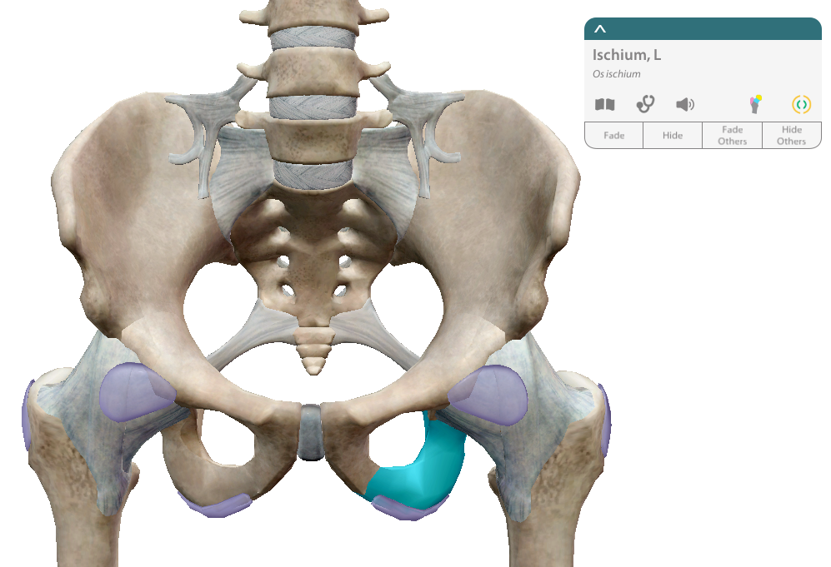
Ischium

Slide 29
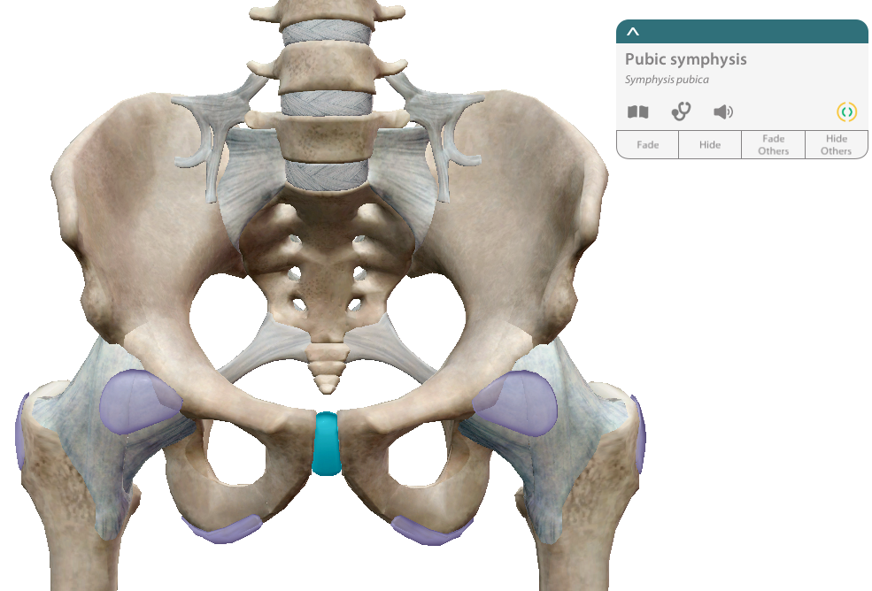
Pubic Symphysis

Slide 30
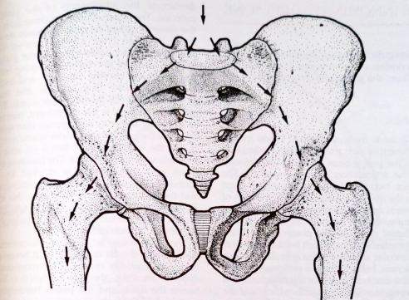
Pelvic girdle functions
Supports Lx
Connects spine and pelvis
Transmits forces from spine into lower limbs (and vice versa)
Serves as attachment sites for muscles of the trunk and lower limb
Contains and protects reproductive organs
In females, it provides bony support for the birth canal

Slide 31
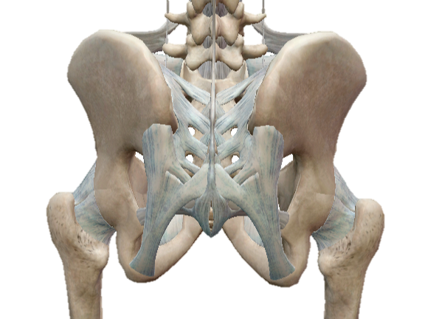
SIJ

Slide 32
Functional anatomy
Made up of Sacrum and Illium
Capsule and anterior sacroiliac ligament situated anteriorly
Posterior is largely fibrous ligaments (posterior sacroiliac ligament and interosseous ligament)
Very stable so small ROM – 2-3mm (Goode et al., 2008)
Sacrum not mobilised by muscles - All surrounding muscles stabilise

Slide 33
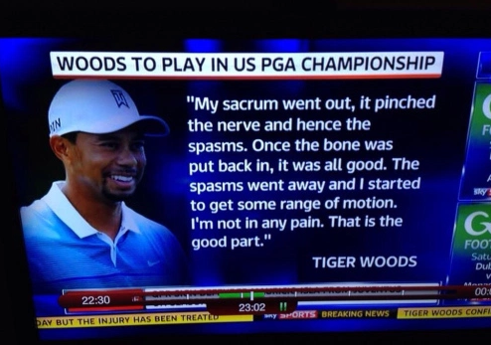

Slide 34
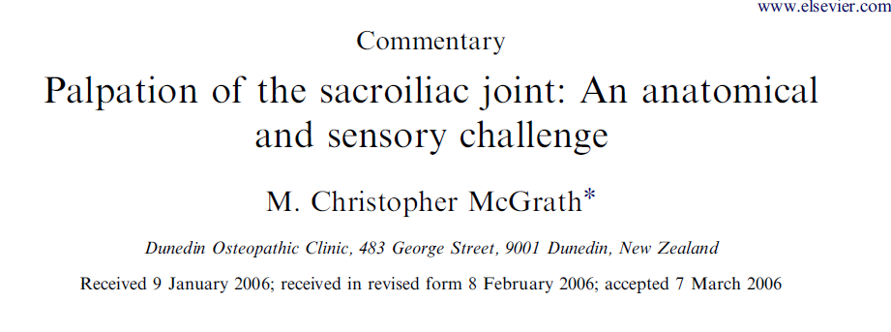
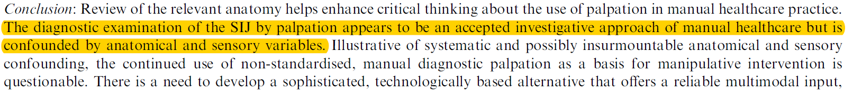
Palpation

Slide 35
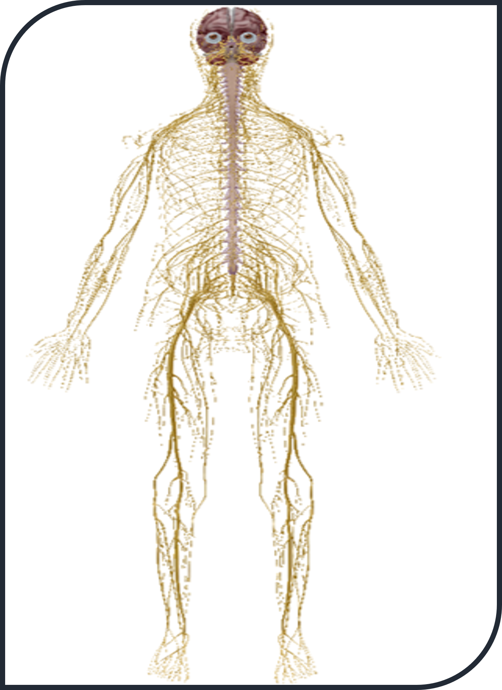
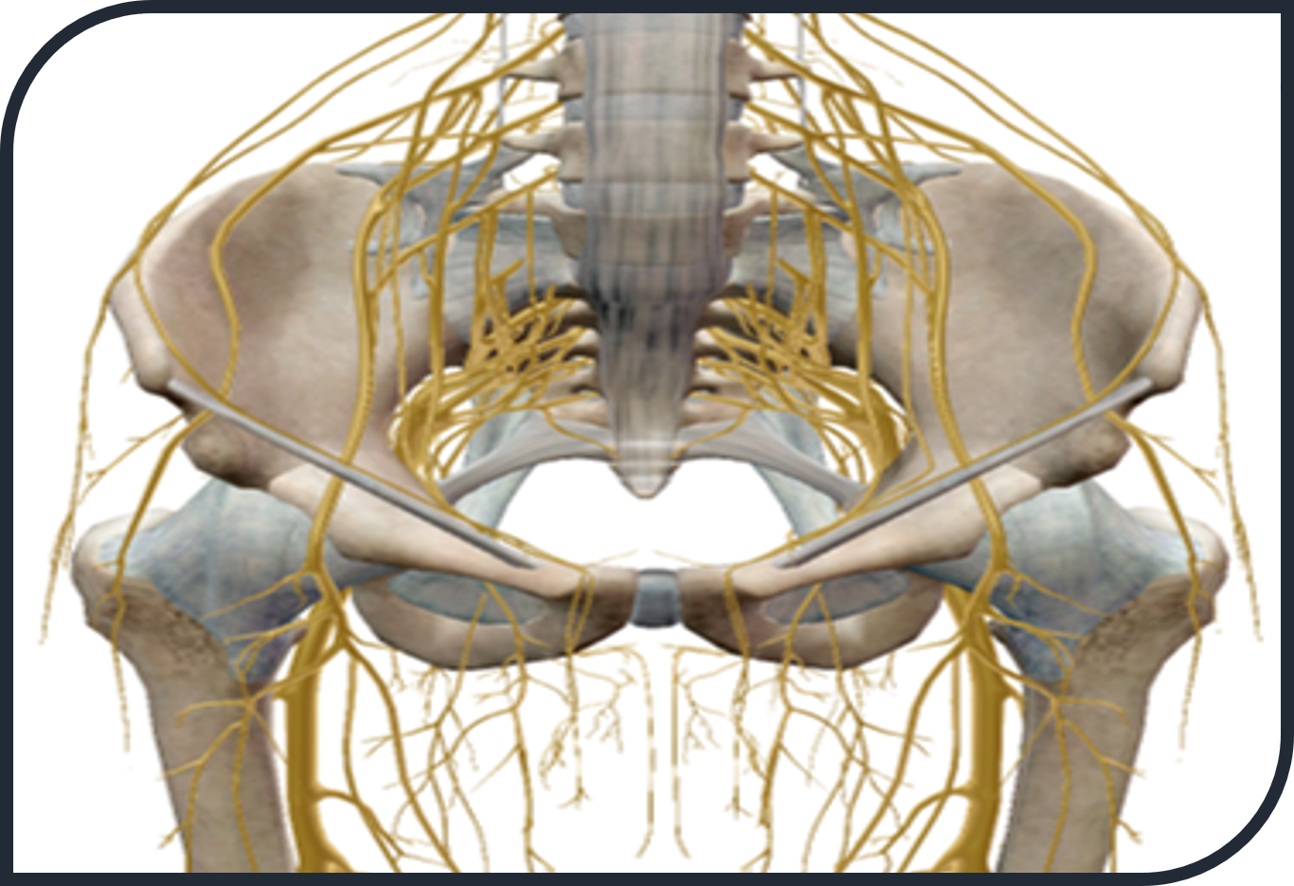
Lumbosacral nerve anatomy

Slide 36
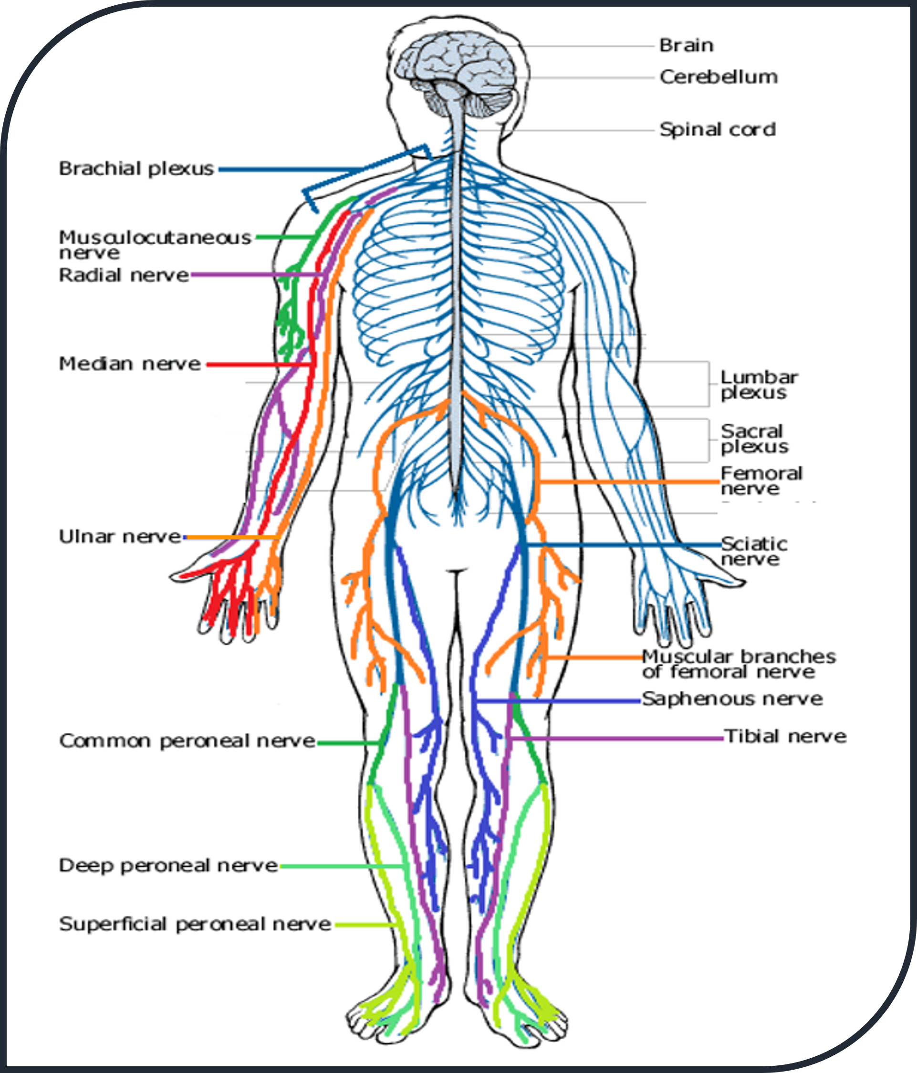
Neural pathways
You need to be aware of all peripheral nerves inc. ones not shown here!
It is important you know their pathway, as well as their dermatological and muscular innervation
‘To test and to treat’

Slide 37
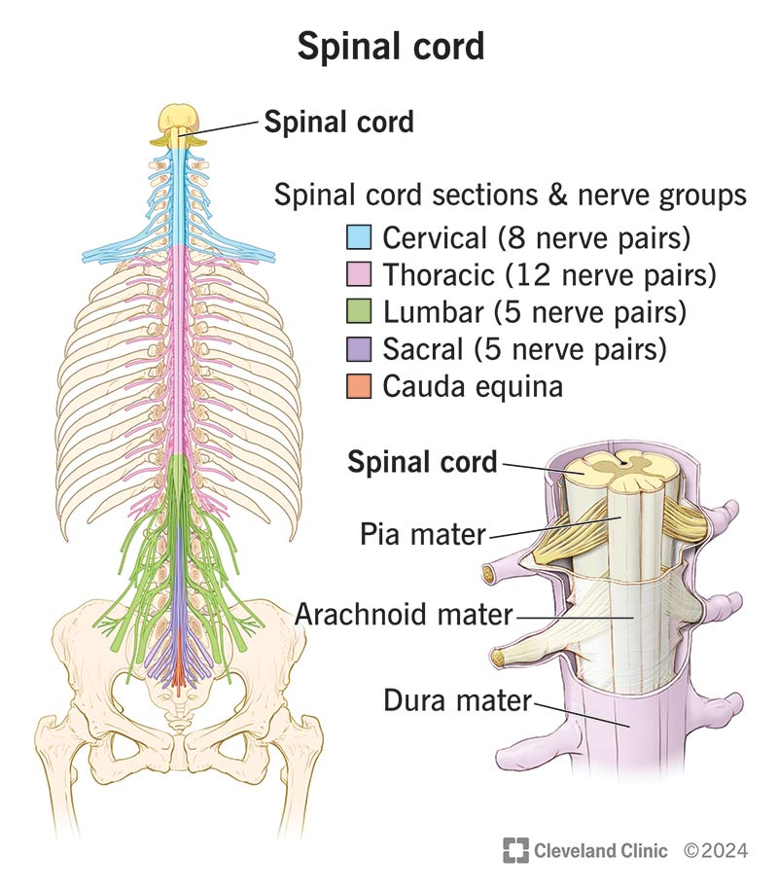
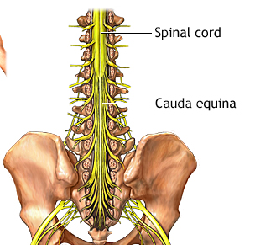
Spinal cord segment

